Slide 1
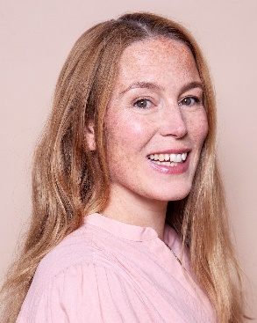
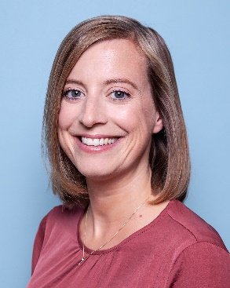
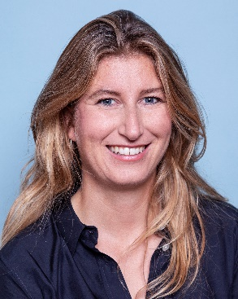
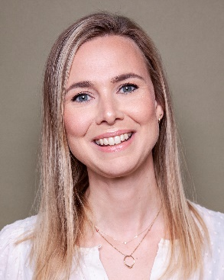
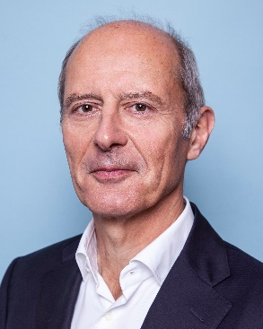
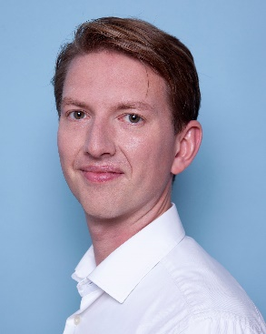
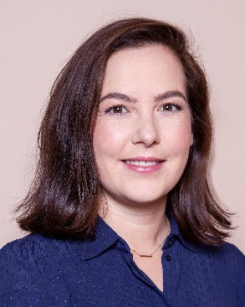
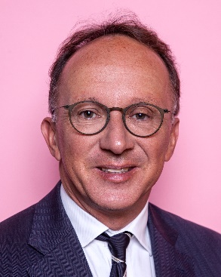
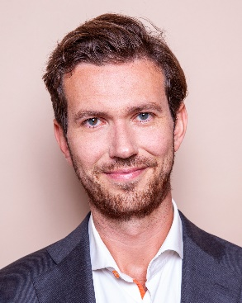
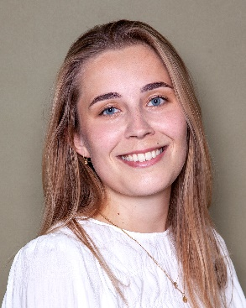
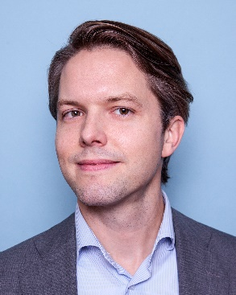
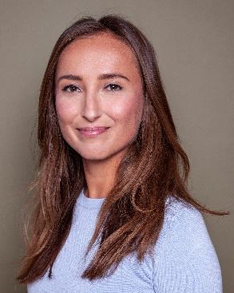

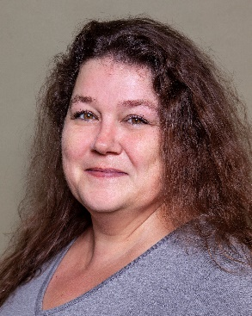
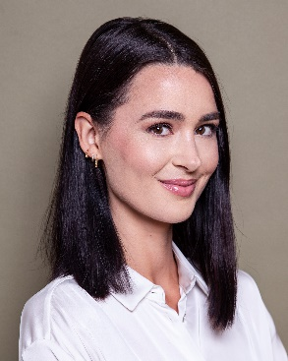
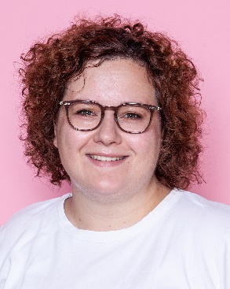
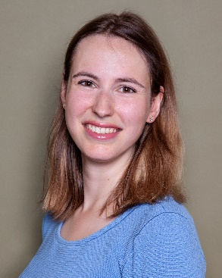
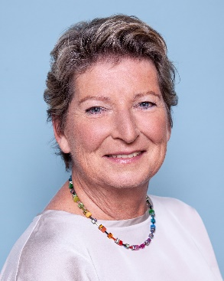
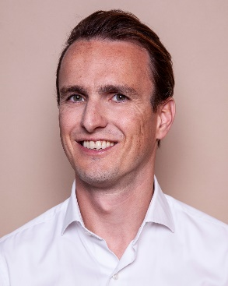
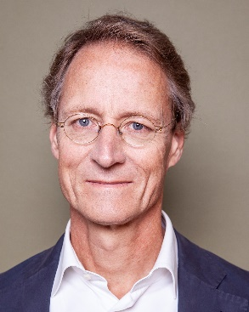
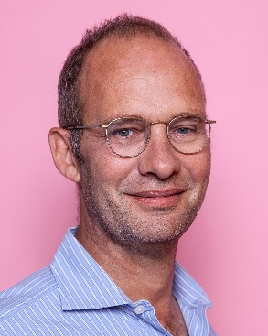
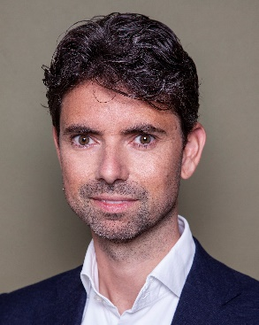
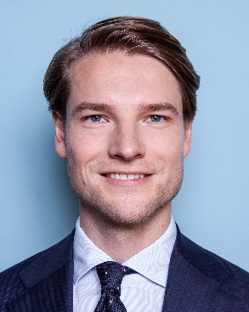

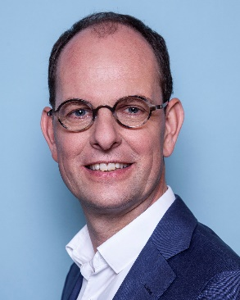
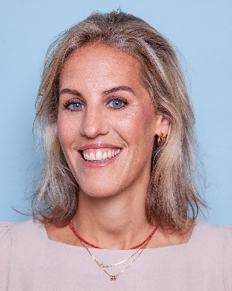
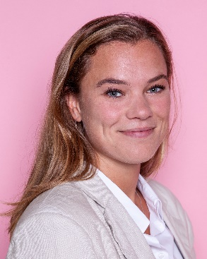

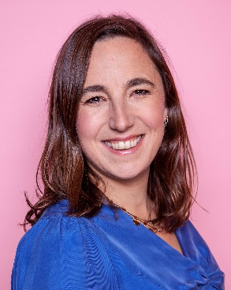
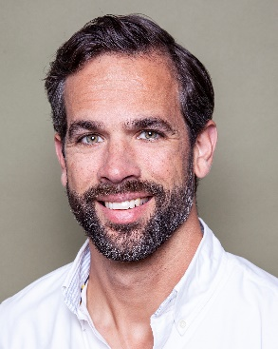
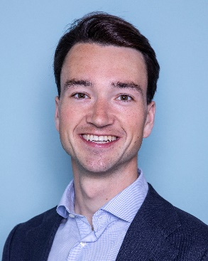
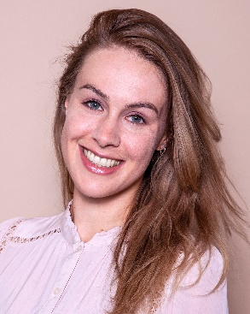
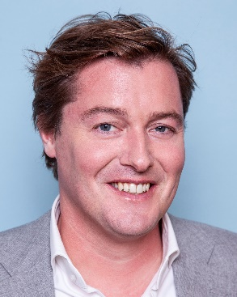

FIRM Presentation IBA miami 2022
Name + Last name
Job title

Slide 2
Introduction
Rutgers & Posch is an independent multiservice law firm established in 2013, located in the heart of Amsterdam
The combination of Big Law expertise and a boutique set-up characterizes our firm.
We provide clients with top quality service combined with personal attention, dedication and involvement
We customize our service to our clients’ needs with a special focus on long lasting relationships
We are pragmatic and keep our communication lines short

Slide 3




Our core expertise
Mergers & acquisitions
Collaborations
Governance-related issues
Investigations by and discussions with healthcare insurers
Investigations by and discussions with supervisory authorities (ACM, Nza and IGJ)
Privacy-related issues in healthcare
Mergers and acquisitions
Innovative investment/financing solutions
Employee participation schemes
Data protection
Privacy
Commercial contracts
Healthcare
DIGITAL MEDIA & TECHNOLOGY
Borrowing base facilities
Securitisations
Restructurings and insolvencies
Mergers and acquisitions
Joint ventures
Corporate governance
Contracts
Disputes
Product terms and conditions
Real estate
Employment, pension and benefits
Lending by, and funding of, financial institutions
Portfolio transactions
Restructurings and insolvencies
Mergers and acquisitions
Corporate governance
Duty of care
Financial supervision
Product terms and conditions
Real estate
Claims
Employment, pension and benefits
FINANCIAL INSTITUTIONS
Mobility

Slide 4






OUR CORE EXPERTISE
CORPORATE and M&A
COMMERCIAL CONTRACTS
EMPLOYMENT, PENSIONS & BENEFITS
FINANCE & PORTFOLIOS
RESTRUCTURING & INSOLVENCY
DISPUTE RESOLUTION
Notes:
Kijken of ik bij digitale kantoor presentatie kan doorklikken naar pagina op website (voorstel Matthijs)

Slide 5

Press
How we get results
International experience
Battle tested
Highly motivated

Slide 6
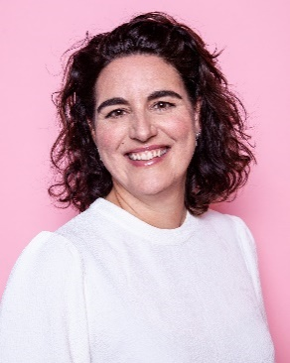
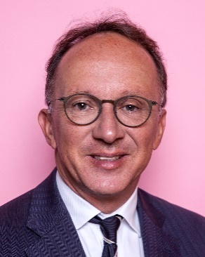
IBA delegation rutgers & Posch
Inge de laat engages in all aspects of employment law, including collective and individual dismissals, mergers and acquisitions and outsourcing. She also advises and litigates in the area of health law and privacy / data protection. Inge furthermore advises national and international clients on the operation of the works councils act. Inge publishes and teaches regularly on her areas of expertise. She is editor of the journal arbeidsrecht and a board member of the association of employment lawyers Amsterdam.
Before joining Rutgers & Posch Inge was a partner at Kennedy van der laan.
Dirk Jan Rutgers is an employment law and health law specialist. National and international clients regularly seek his strategic advice in complex employment law proceedings concerning, for example, mergers, reorganisations, and dismissals. He also has ample experience with cross-border disputes, equal treatment, flexible employment relations and privacy. Furthermore, Dirk Jan advises healthcare institutions on a broad variety of issues, specialising in the collaboration between health care institutions and the relationship between medical specialists and management. Before joining Rutgers & Posch, Dirk Jan was a partner at DLA Piper
Dirk Jan Rutgers
Partner
Inge de Laat
Managing partner

Slide 7


IBA delegation rutgers & Posch
Lennaert Posch specialises in corporate and financial transactions, often in an international context. He particularly focusses on mergers and acquisitions, joint ventures, investments and corporate reorganisations. Lennaert also has in depth experience in the field of corporate finance, in particular acquisition, project and real estate finance. He also advises on corporate governance and other corporate law issues. Lennaert is admitted to the New York Bar and has a large international network in North America and Asia. Before joining Rutgers & Posch, Lennaert was a partner at Stibbe in Amsterdam and the resident partner in New York.
Loek is a specialist in insolvency law. As a highly experienced lawyer, loek has worked on numerous high-profile insolvencies and complex domestic and international restructurings. Loek advises companies in distress, directors, shareholders and creditors. His specific area of expertise is insolvency litigation, such as disputes about liability (including director’s liability), claims for fraudulent conveyance (actio pauliana) and enforcement of security rights.
Loek also has broad commercial litigation experience.
Lennaert Posch
Partner
Loek Kerstens
Partner

Slide 8


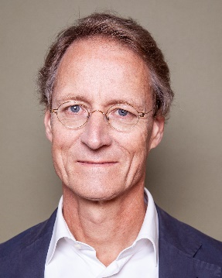

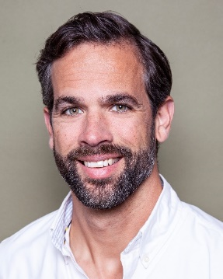

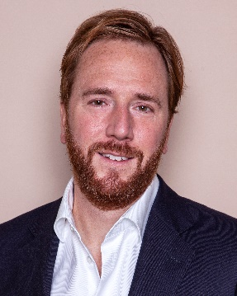
Our other partners
Bas ViséE
Matthijs van den Broek
Kees Westermann
Tijmen Noordoven
Partner Corporate M&A
Partner Corporate M&A
Partner Finance
Partner Employment
Bas Visée
Matthijs van den Broek
Kees Westermann
Tijmen Noordoven
RIK Analbers
Huib Schrama
Bas MEes
Partner Litigation
Partner Litigation
Partner Corporate M&A
Rik Analbers
Huib Schrama
Bas Mees

Slide 9






Selection of clients

Slide 10
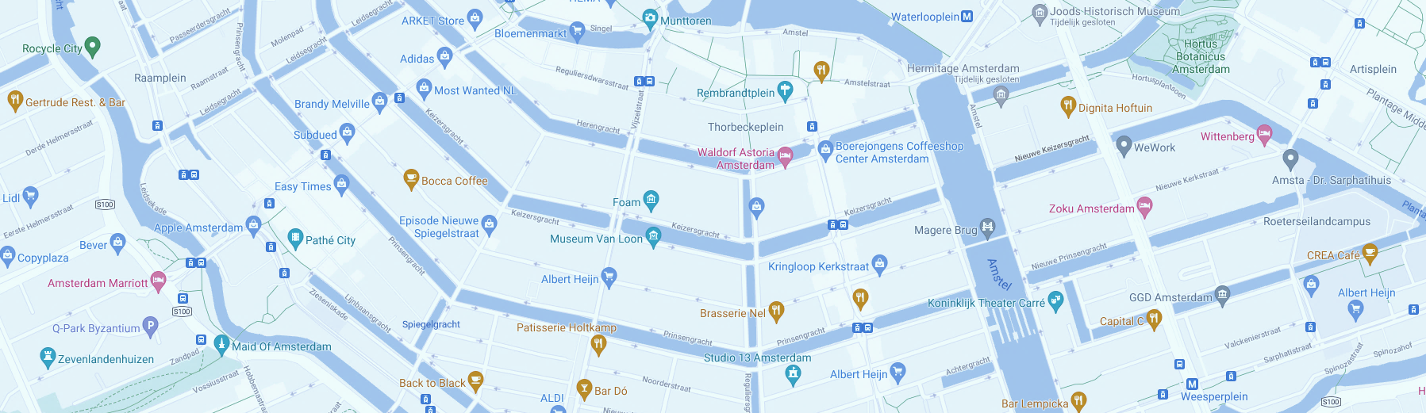

CLOSING SLIDE #3 LOCATIONS
Office
POSTAL ADDRESs
contact
Herengracht 466
1017 CA Amsterdam
The Netherlands
PO Box 10896
1001 EW Amsterdam
The Netherlands
+31 20 891 3900
info@rutgersposch.com
linkedin.com/company/rutgers-&-posch

